Slide 1
To Do:
Known variables vs disease score (& trajectories)
Time to outcome/event vs disease score
Disease score (1st visit) vs re-calculated disease score (2nd imaging visit) for known variables

Slide 2
Variable Vs Hyper Score

Slide 3
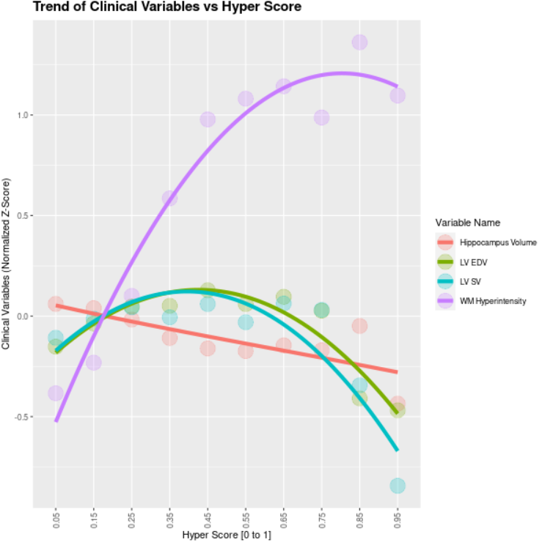
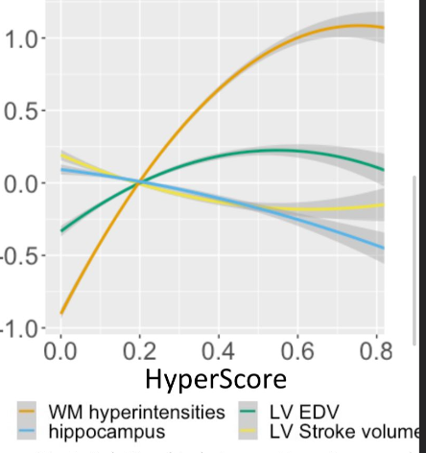
Split Hyper Score into Intervals and Plot Means of Variables per Interval

Slide 4
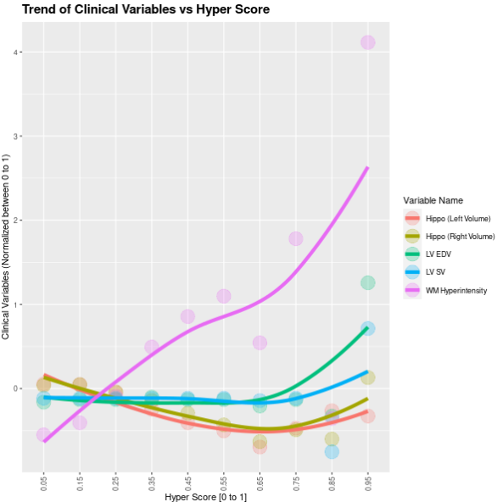
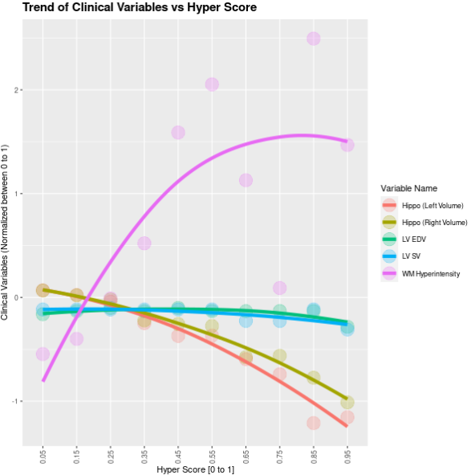
All Variables (No Ft Selection)
Co-Cor Ft Selection Only
(Imbalanced Brain/Body Comp Variables)

Slide 5
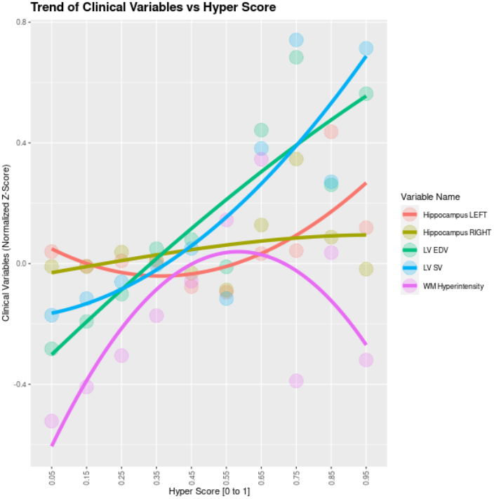
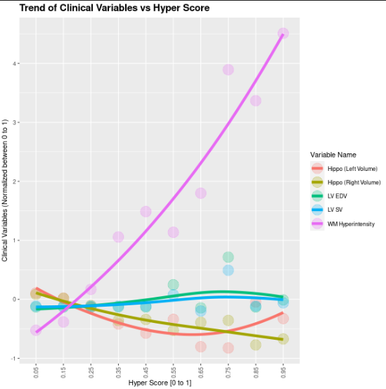
Co-Cor Ft Selection + Brain
Co-Cor Ft Selection + Body Comp

Slide 6
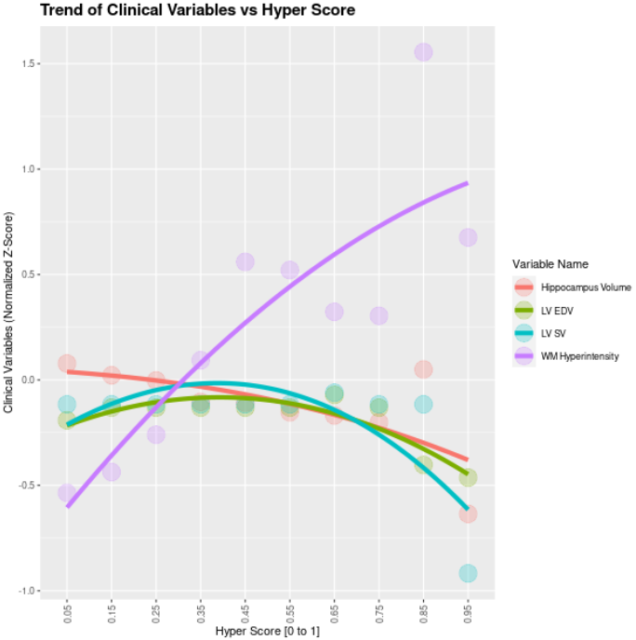
Mean per (10) intervals
Median per (10) intervals

Slide 7
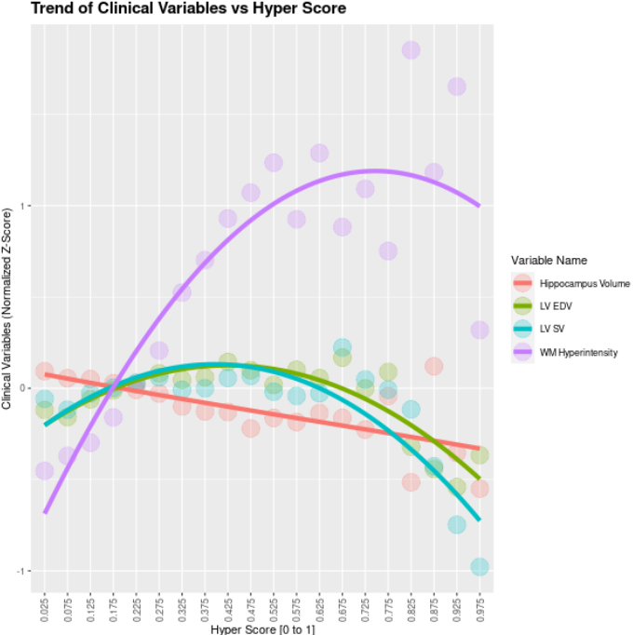
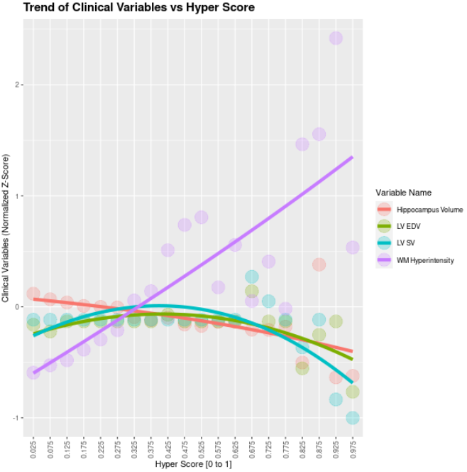
Mean per (20) intervals
Median per (20) intervals

Slide 9
Variable Vs Hyper Score Per Trajectory

Slide 10
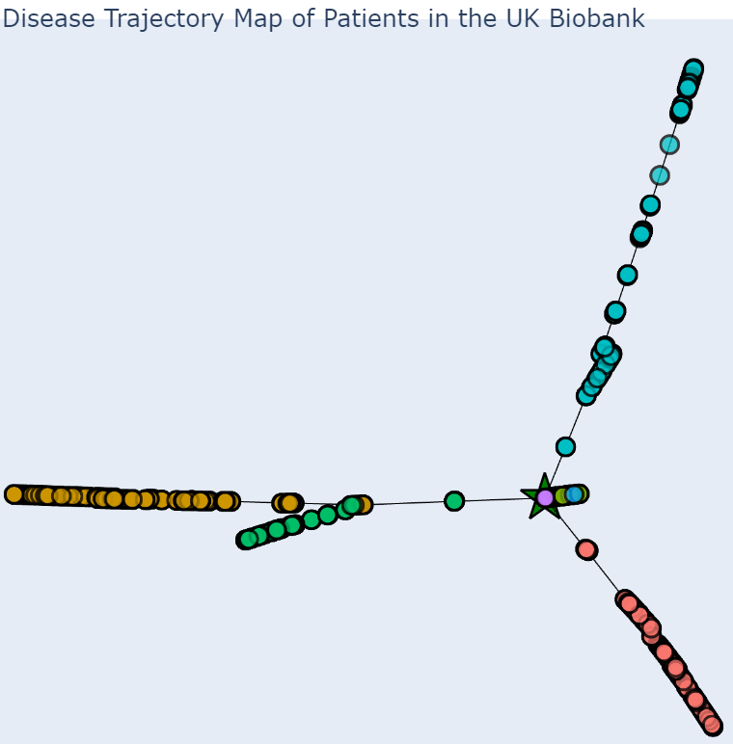
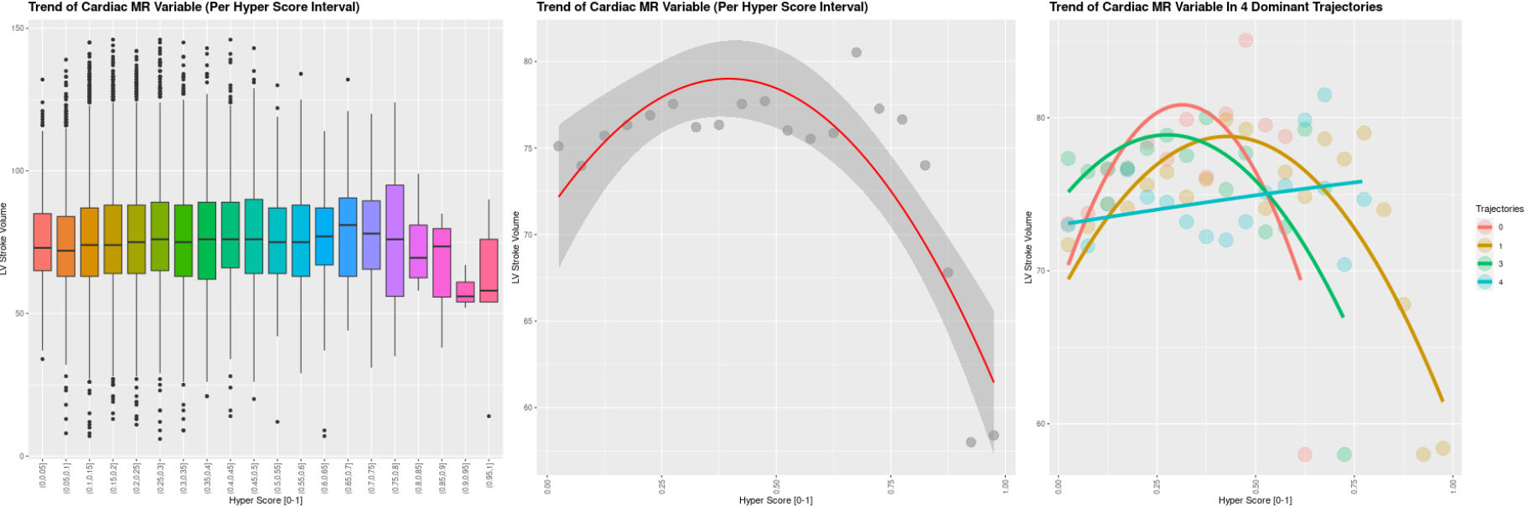
LV Stroke Volume

Slide 11
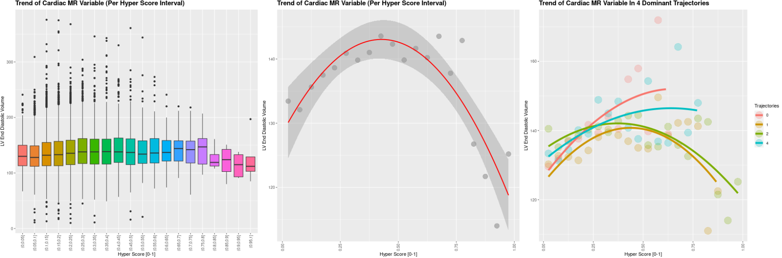
LV End Diastolic Volume

Slide 12
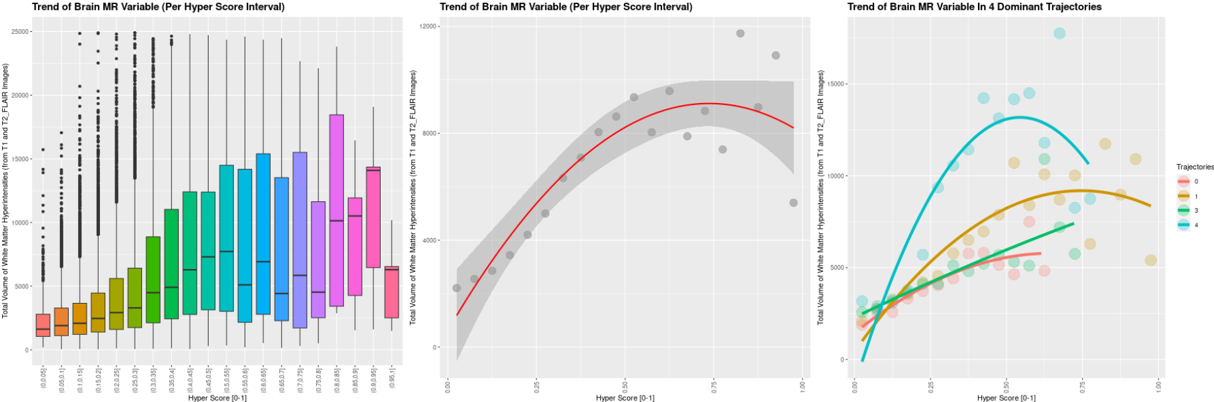
White Matter Hyperintensities

Slide 13
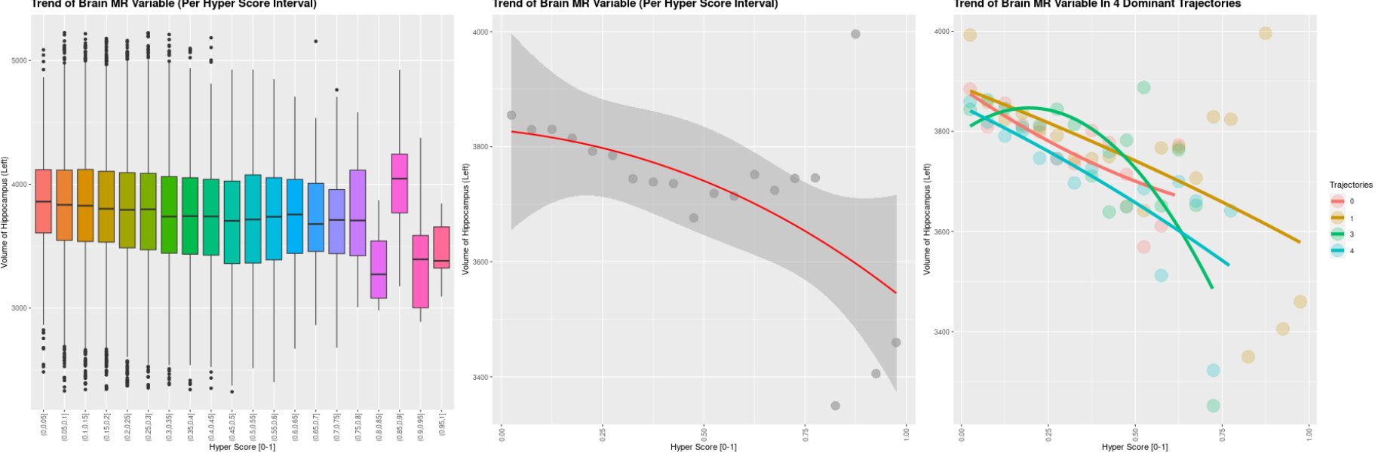
Volume of Hippocampus

Slide 14
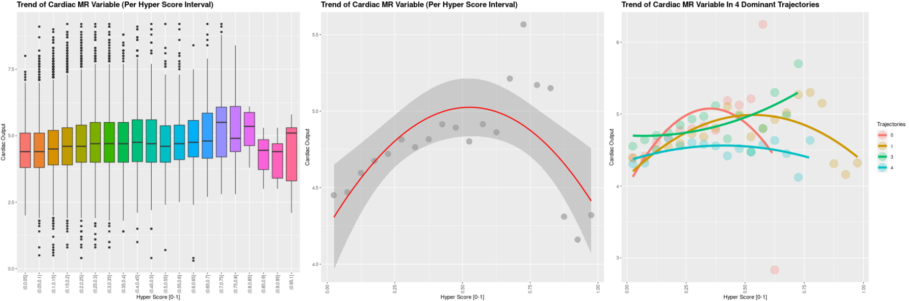
Cardiac Output

Slide 15
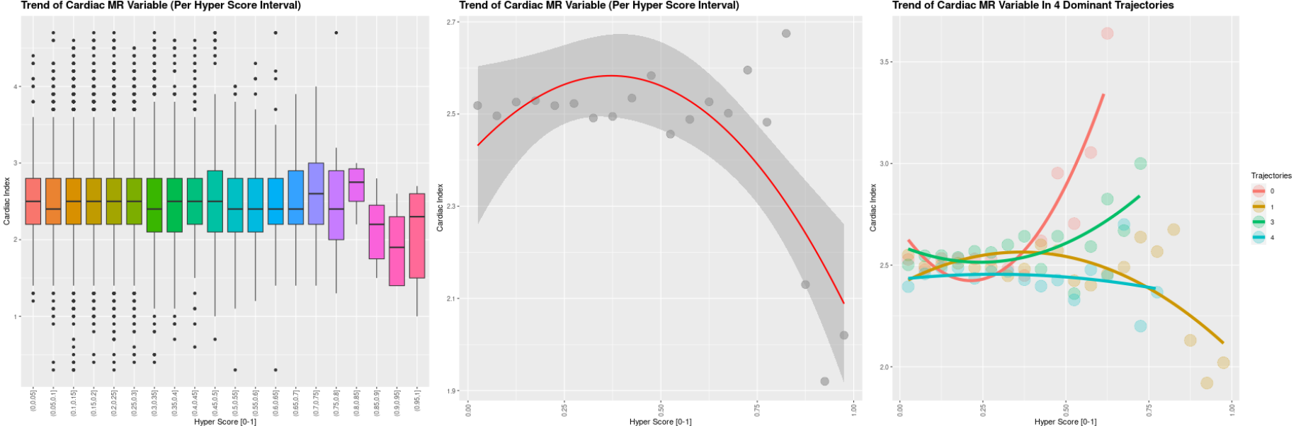
Cardiac Index

Slide 16
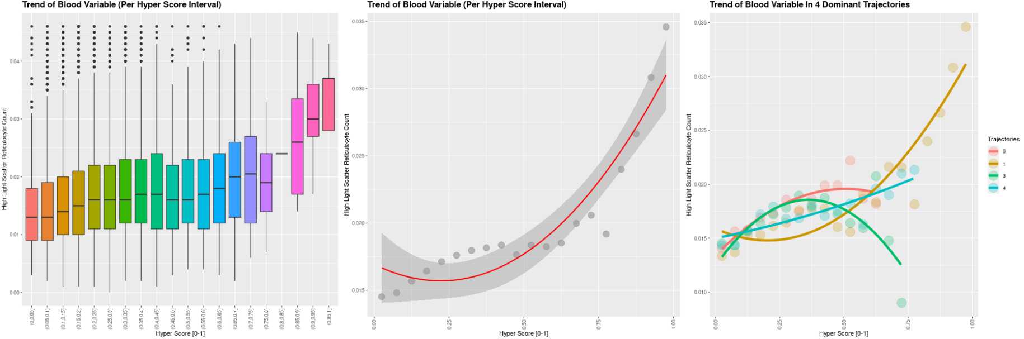
High Light Scatter Reticulocyte

Slide 17
Outcome vs Hyper Score

Slide 18
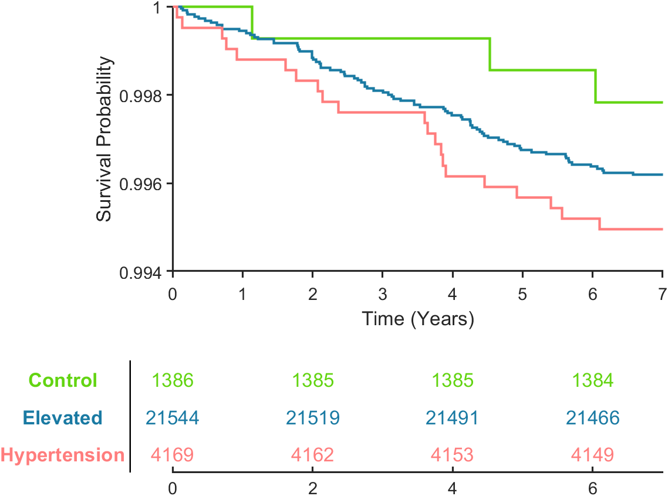
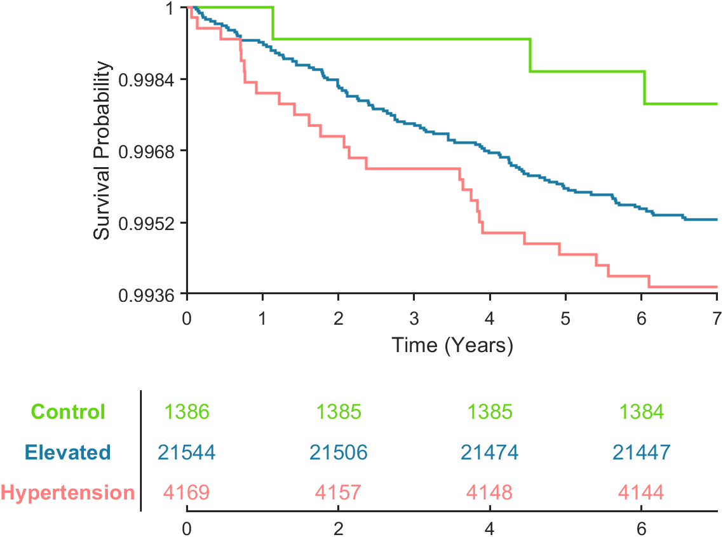
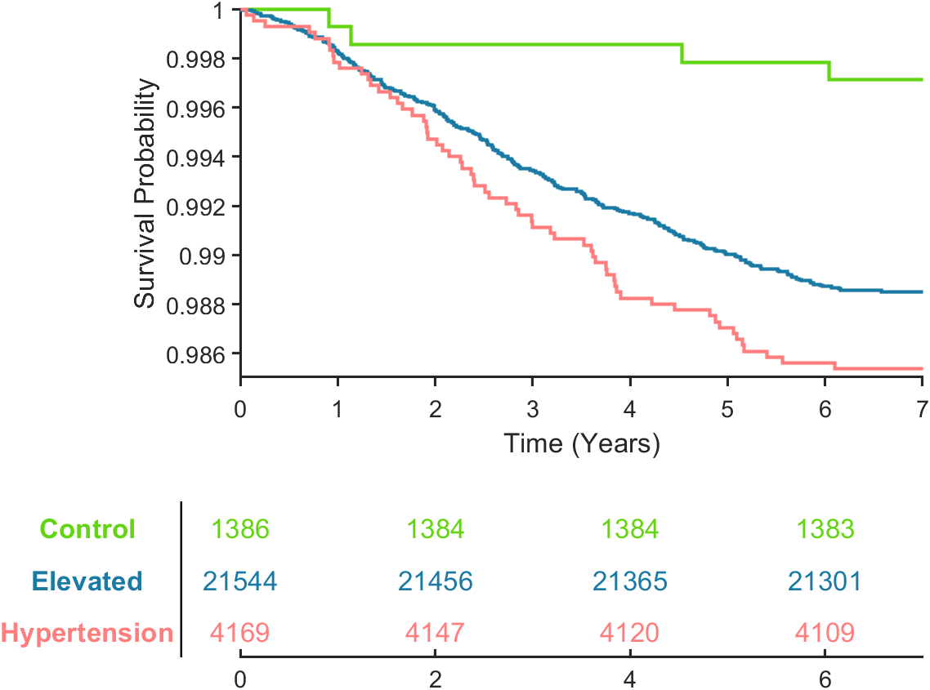
1
Categorised based on blood pressure
Circulatory diseases deaths
Circulatory diseases deaths and all events
(heart attack, stroke, angina)
All-cause death
# | Categories | Overall p-value | Pair-wise p-value |  |  |  |  |  | Median years to death
 |  |  | Green Blue | Green Orange | Green Red | Blue Orange | Blue Red | Red Orange
Circulatory diseases deaths
1 | <120/80 120/80>BP>160/100 >160/100 | 0.2857 | 0.330 | / | 0.158 | / | 0.249 | / | 3.90 3.08 2.93
Circulatory diseases deaths + other events (heart attack, stroke, angina)
1 | <120/80 120/80>BP>160/100 >160/100 | 0.150 | 0.170 | / | 0.068 | / | 0.207 | / | 4.53 2.70 2.07
All-cause deaths
1 | <120/80 120/80>BP>160/100 >160/100 | 0.002 | 0.003 | / | <0.001 | / | 0.090 | / | 1.13 2.64 2.51

Slide 19
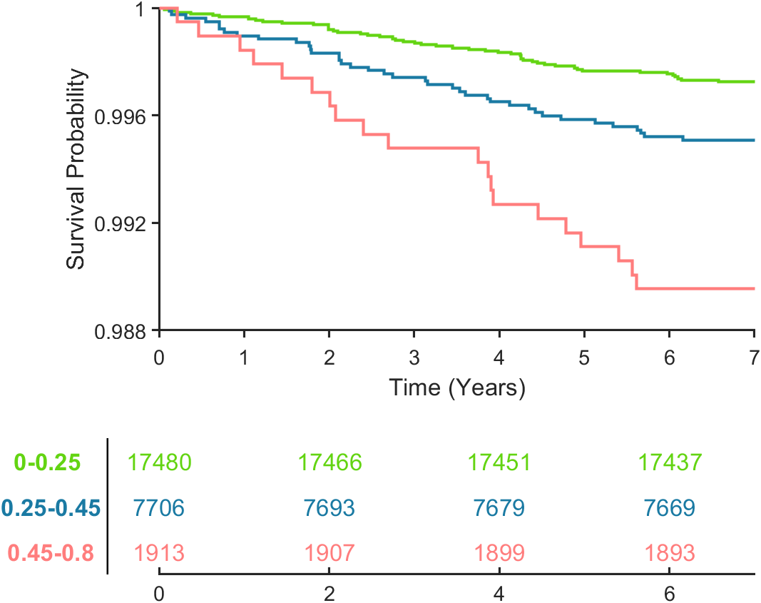
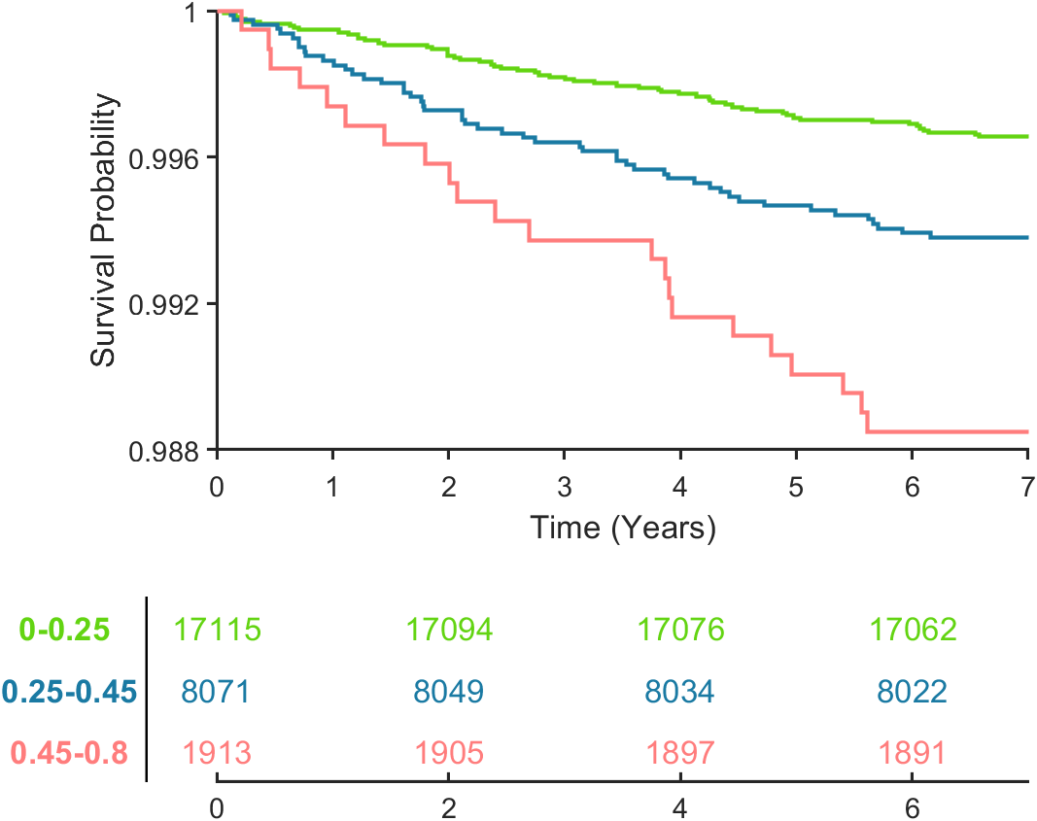
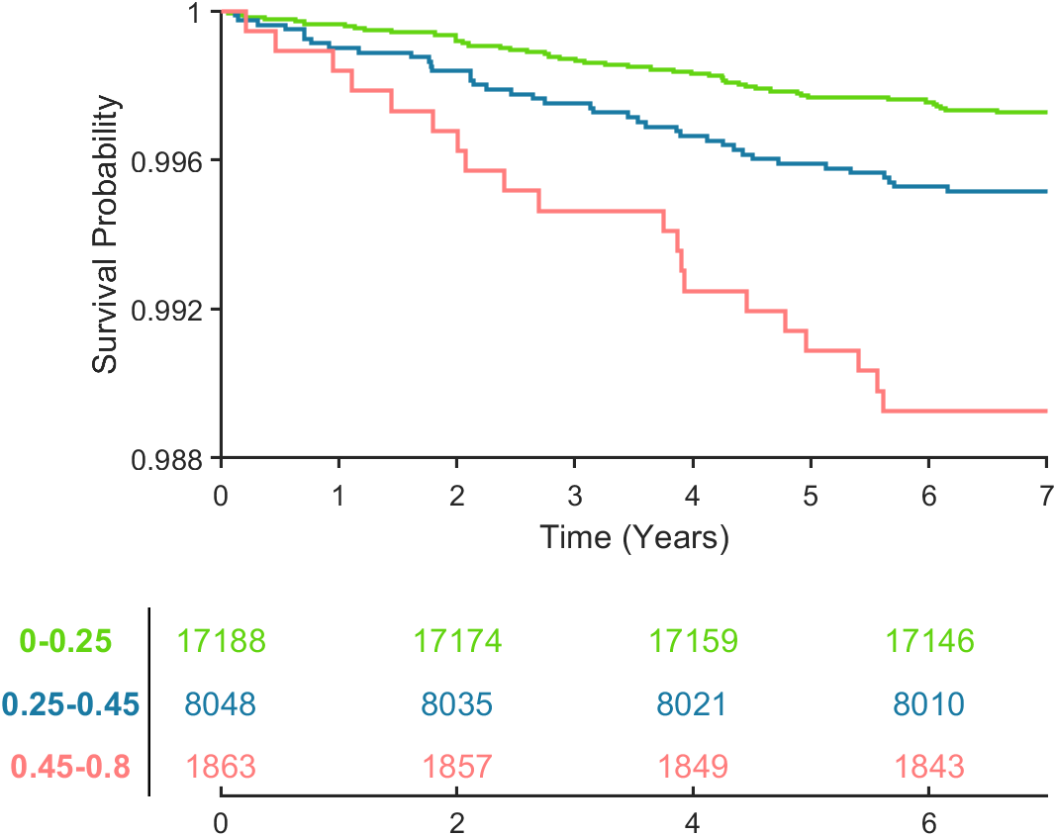
2
Categorised based on hyperscore (k-means / 3-class)
Circulatory diseases deaths
Circulatory diseases deaths and all events
(heart attack, stroke, angina)
All-cause death
# | Categories | Overall p-value | Pair-wise p-value |  |  |  |  |  | Median years to death
 |  |  | Green Blue | Green Orange | Green Red | Blue Orange | Blue Red | Red Orange
Circulatory diseases deaths
2 | 0-0.25 0.25-0.45 0.45-0.8 | <0.001 | 0.006 | / | <0.001 | / | 0.005 | / | 3.08 2.74 2.70
Circulatory diseases deaths + other events (heart attack, stroke, angina)
2 | 0-0.25 0.25-0.45 0.45-0.8 | <0.001 | 0.002 | / | <0.001 | / | 0.014 | / | 2.78 2.14 2.41
All-cause deaths
2 | 0-0.25 0.25-0.45 0.45-0.8 | <0.001 | 0.007 | / | <0.001 | / | 0.003 | / | 2.62 2.54 3.17

Slide 20
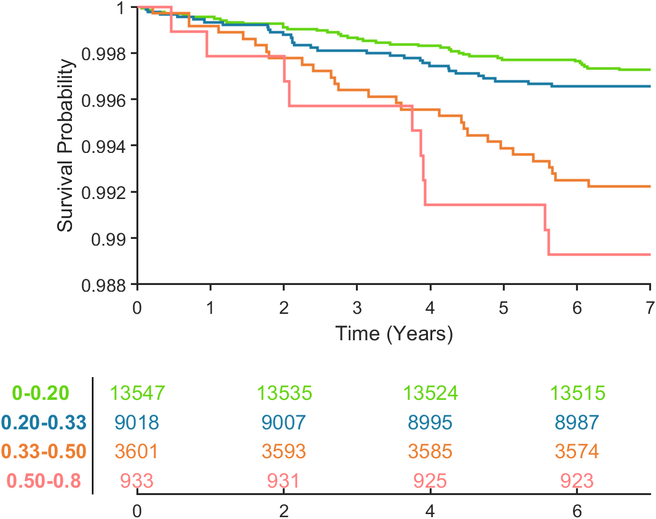
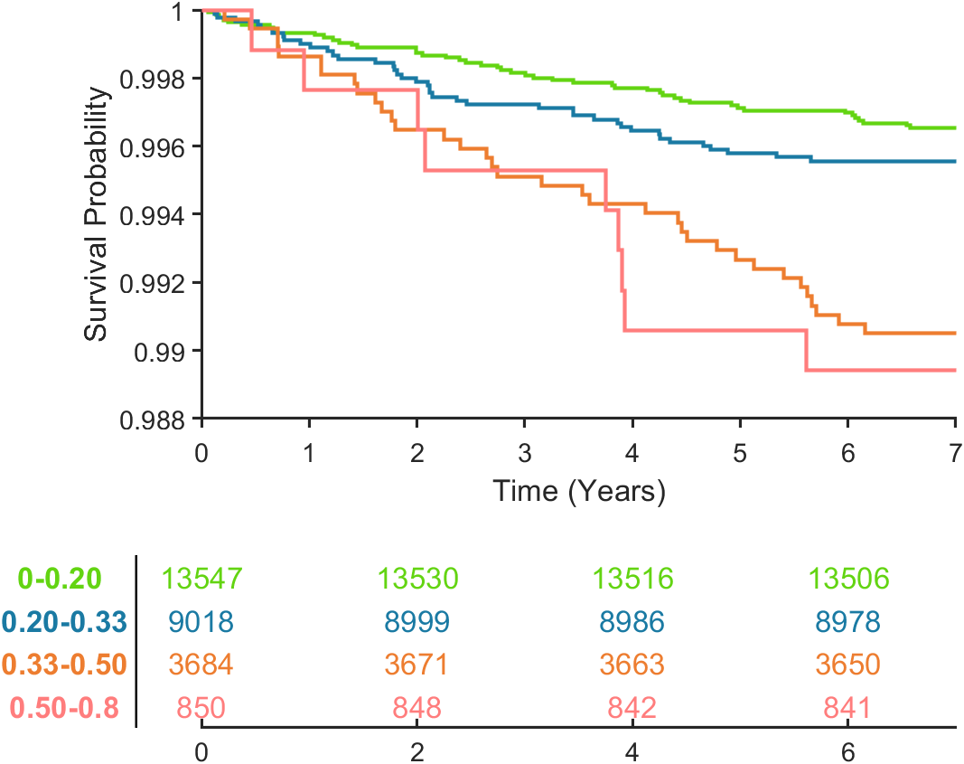
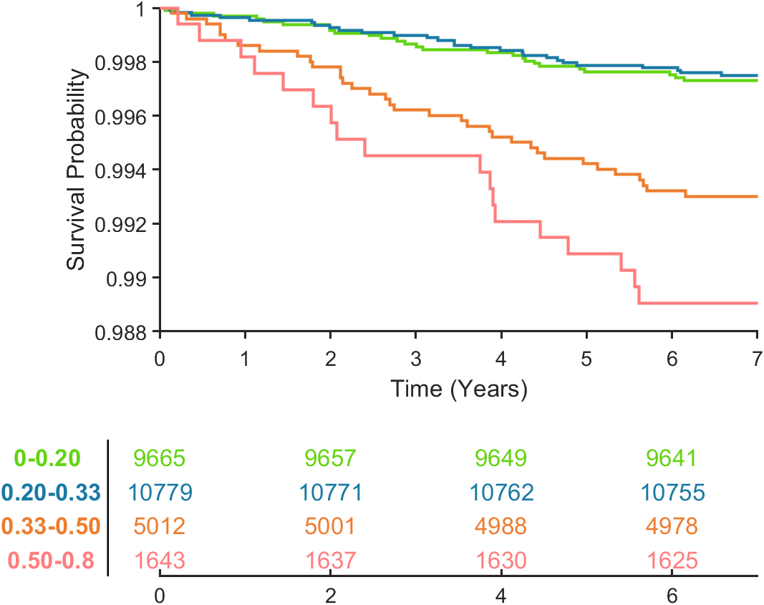
3
Categorised based on hyperscore (k-means / 4-class)
Circulatory diseases deaths
Circulatory diseases deaths and all events
(heart attack, stroke, angina)
All-cause death
# | Categories | Overall p-value | Pair-wise p-value |  |  |  |  |  | Median years to death
 |  |  | Green Blue | Green Orange | Green Red | Blue Orange | Blue Red | Red Orange
Circulatory diseases deaths
3 | 0-0.20 0.20-0.33 0.33-0.50 0.50-0.8 | <0.001 | 0.343 | <0.001 | <0.001 | 0.001 | <0.001 | 0.379 | 3.01 2.37 3.53 3.75
Circulatory diseases deaths + other events (heart attack, stroke, angina)
3 | 0-0.20 0.20-0.33 0.33-0.50 0.50-0.8 | <0.001 | 0.251 | <0.001 | 0.001 | <0.001 | 0.015 | 0.770 | 2.78 2.10 2.74 3.75
All-cause deaths
3 | 0-0.20 0.20-0.33 0.33-0.50 0.50-0.8 | <0.001 | 0.795 | <0.001 | <0.001 | 0.001 | <0.001 | 0.116 | 2.62 2.54 2.65 2.73

Slide 21
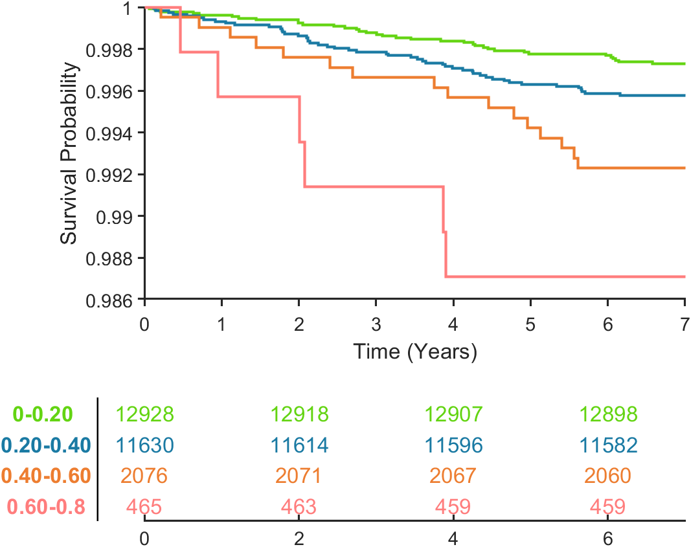
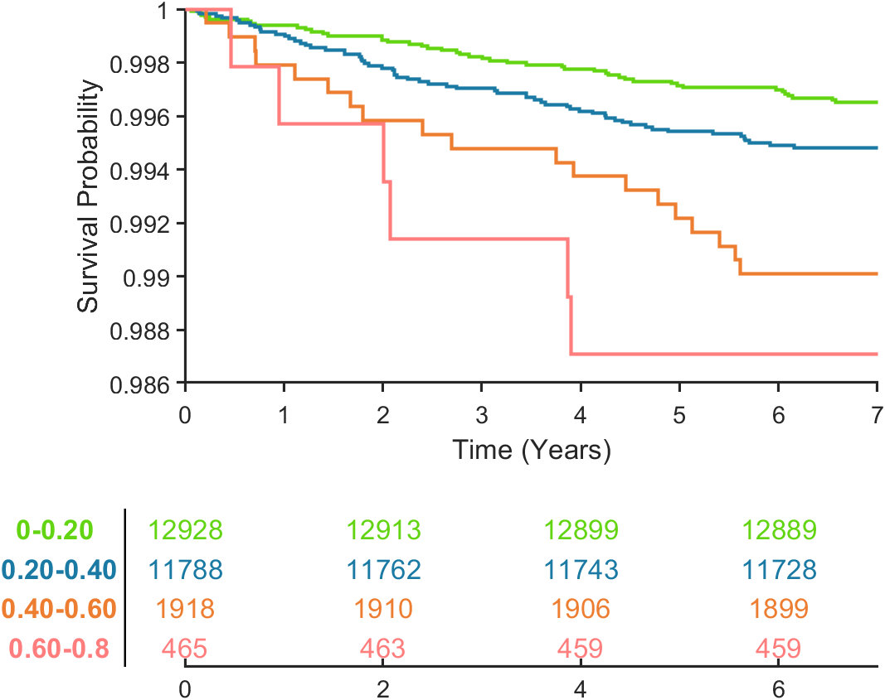
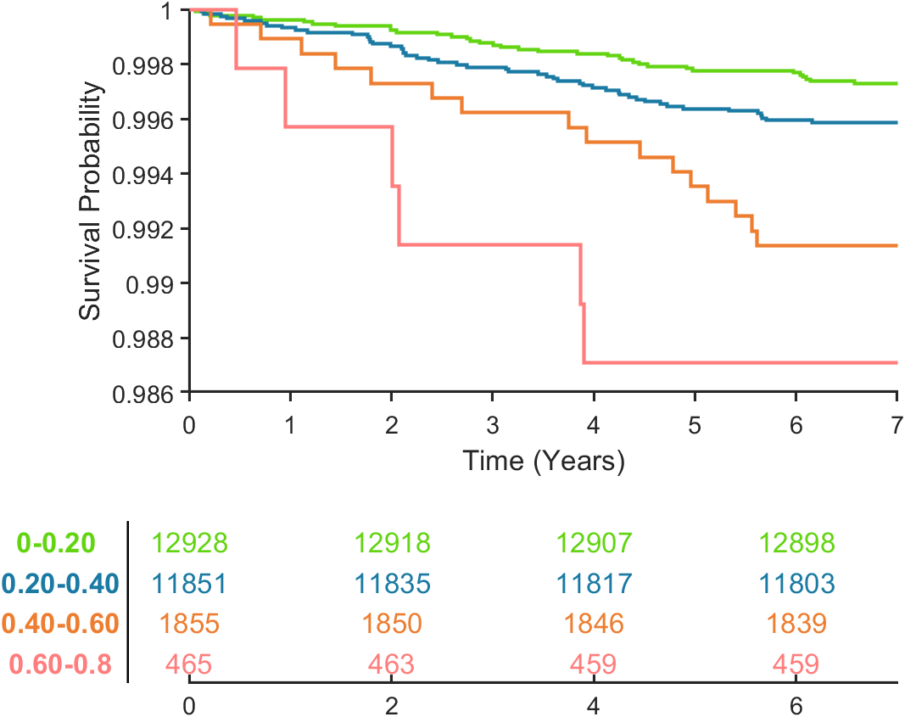
4
Categorised based on hyperscore (0.2 ranges)
Circulatory diseases deaths
Circulatory diseases deaths and all events
(heart attack, stroke, angina)
All-cause death
# | Categories | Overall p-value | Pair-wise p-value |  |  |  |  |  | Median years to death
 |  |  | Green Blue | Green Orange | Green Red | Blue Orange | Blue Red | Red Orange
Circulatory diseases deaths
4 | 0-0.20 0.20-0.40 0.40-0.60 0.60-0.8 | <0.001 | 0.044 | <0.001 | <0.001 | 0.033 | 0.006 | 0.272 | 3.08 2.74 3.75 2.01
Circulatory diseases deaths + other events (heart attack, stroke, angina)
4 | 0-0.20 0.20-0.40 0.40-0.60 0.60-0.8 | <0.001 | 0.042 | <0.001 | 0.001 | 0.012 | 0.026 | 0.567 | 2.88 2.25 2.70 2.01
All-cause deaths
4 | 0-0.20 0.20-0.40 0.40-0.60 0.60-0.8 | <0.001 | 0.053 | <0.001 | <0.001 | 0.009 | 0.005 | 0.391 | 2.75 2.53 3.20 2.01

Slide 22


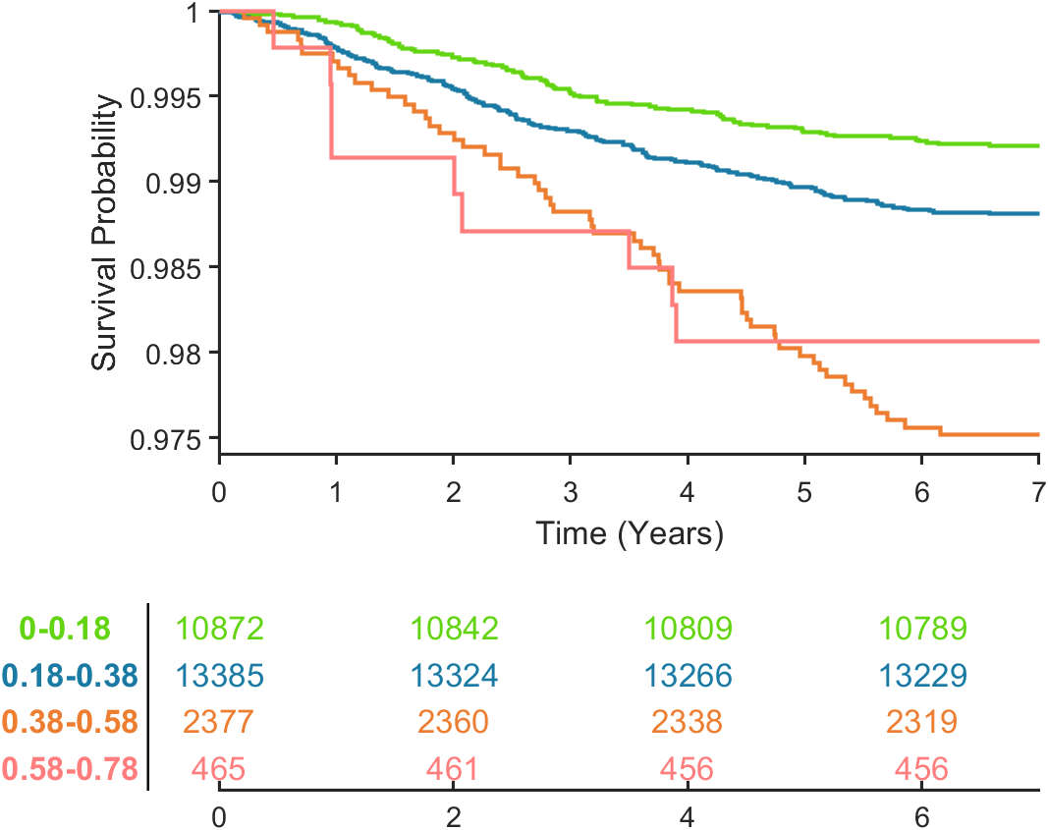
5
Categorised based on hyperscore (0.18 ROC control threshold - 0.2 ranges)
Circulatory diseases deaths
Circulatory diseases deaths and all events
(heart attack, stroke, angina)
All-cause death
# | Categories | Overall p-value | Pair-wise p-value |  |  |  |  |  | Median years to death
 |  |  | Green Blue | Green Orange | Green Red | Blue Orange | Blue Red | Red Orange
Circulatory diseases deaths
5 | 0-0.18 0.18-0.38 0.38-0.58 0.58-0.78 | <0.001 | 0.100 | <0.001 | <0.001 | <0.001 | 0.003 | 0.405 | 3.01 2.74 3.92 2.01
Circulatory diseases deaths + other events (heart attack, stroke, angina)
5 | 0-0.18 0.18-0.38 0.38-0.58 0.58-0.78 | <0.001 | 0.049 | <0.001 | <0.001 | <0.001 | 0.016 | 0.647 | 2.78 2.25 2.75 2.01
All-cause deaths
5 | 0-0.18 0.18-0.38 0.38-0.58 0.58-0.78 | <0.001 | 0.021 | <0.001 | 0.008 | <0.001 | 0.145 | 0.488 | 2.62 2.47 3.18 2.01

Slide 23
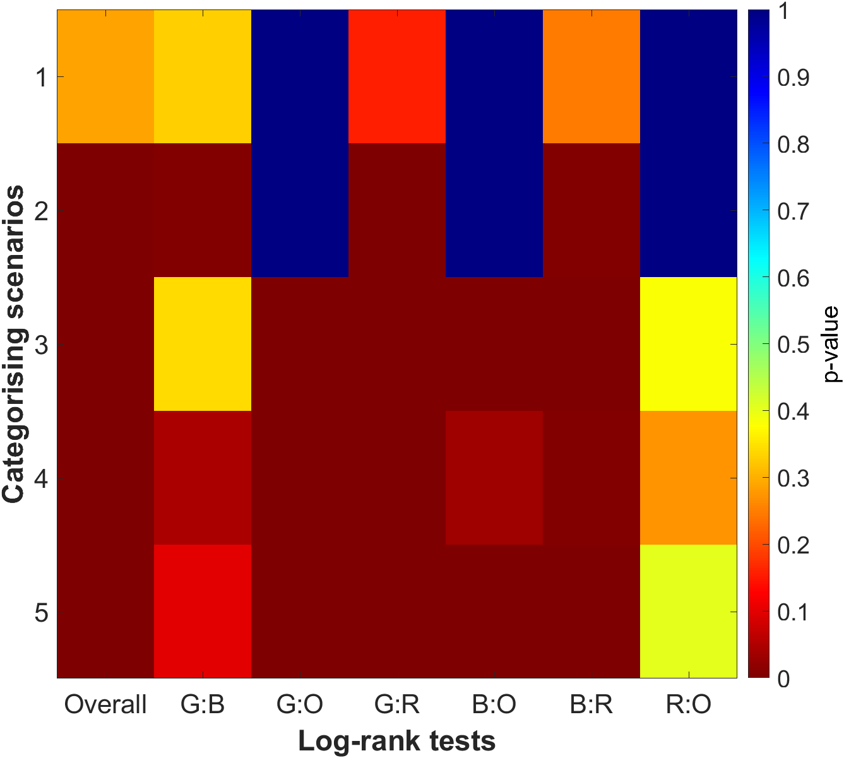
Circulatory diseases deaths
# | Categories | Overall p-value |  |  |  |  |  |  | Median years to death
 |  |  | Green Blue | Green Orange | Green Red | Blue Orange | Blue Red | Red Orange
Circulatory diseases deaths
1 | <120/80 120/80>BP>160/100 >160/100 | 0.2857 | 0.330 | / | 0.158 | / | 0.249 | / | 3.90 3.08 2.93
2 | 0-0.25 0.25-0.45 0.45-0.8 | <0.001 | 0.006 | / | <0.001 | / | 0.005 | / | 3.08 2.74 2.70
3 | 0-0.20 0.20-0.33 0.33-0.50 0.50-0.8 | <0.001 | 0.343 | <0.001 | <0.001 | 0.001 | <0.001 | 0.379 | 3.01 2.37 3.53 3.75
4 | 0-0.20 0.20-0.40 0.40-0.60 0.60-0.8 | <0.001 | 0.044 | <0.001 | <0.001 | 0.033 | 0.006 | 0.272 | 3.08 2.74 3.75 2.01
5 | 0-0.18 0.18-0.38 0.38-0.58 0.58-0.78 | <0.001 | 0.100 | <0.001 | <0.001 | <0.001 | 0.003 | 0.405 | 3.01 2.74 3.92 2.01
Sig.

Slide 24
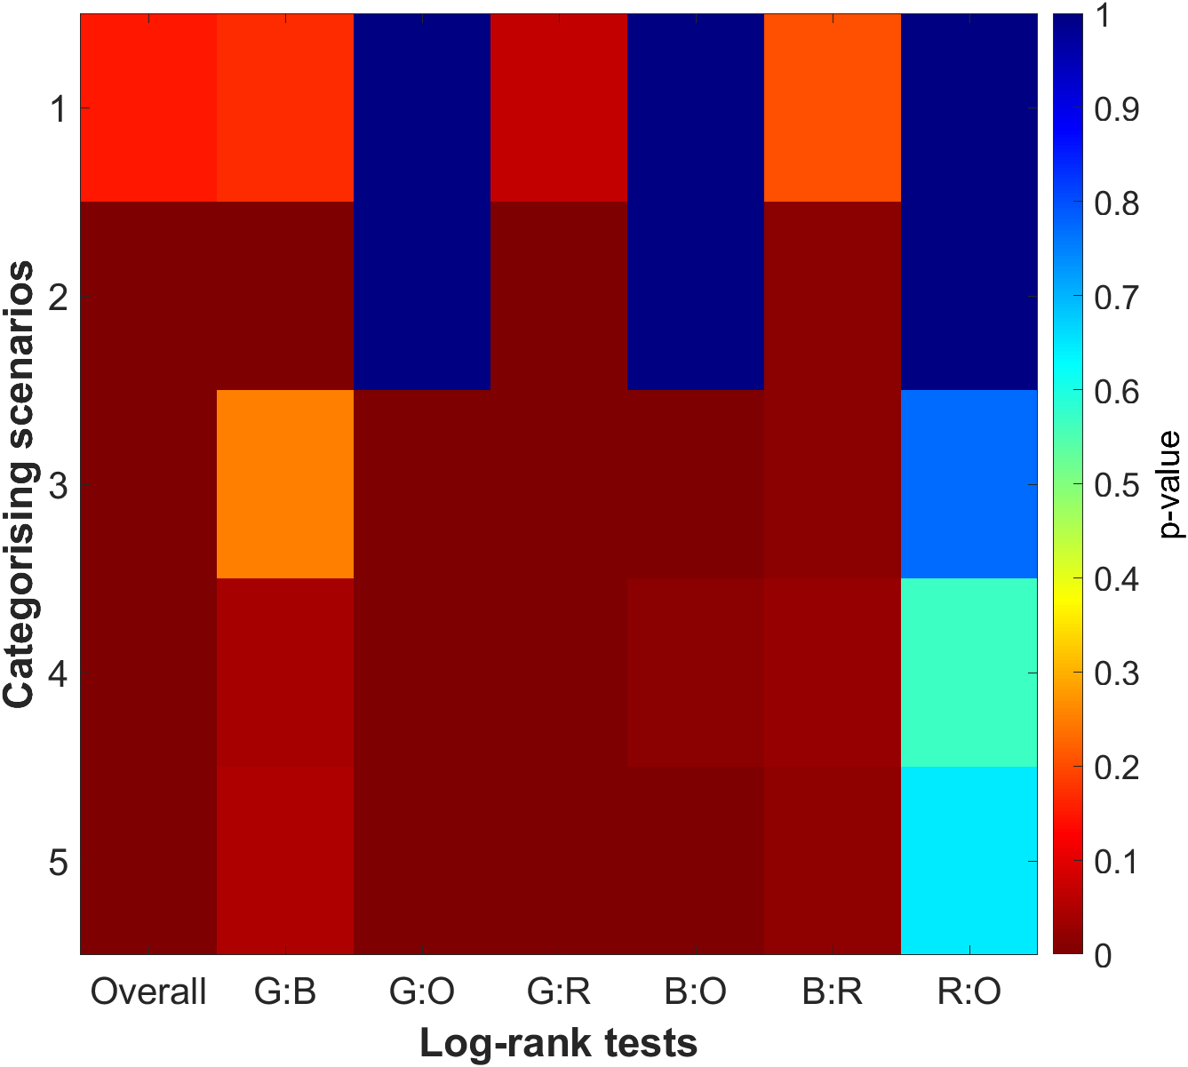
Circulatory diseases deaths + other events (heart attack, stroke, angina)
# | Categories | Overall p-value |  |  |  |  |  |  | Median years to death
 |  |  | Green Blue | Green Orange | Green Red | Blue Orange | Blue Red | Red Orange
Circulatory diseases deaths + other events (heart attack, stroke, angina)
1 | <120/80 120/80>BP>160/100 >160/100 | 0.150 | 0.170 | / | 0.068 | / | 0.207 | / | 4.53 2.70 2.07
2 | 0-0.25 0.25-0.45 0.45-0.8 | <0.001 | 0.002 | / | <0.001 | / | 0.014 | / | 2.78 2.14 2.41
3 | 0-0.20 0.20-0.33 0.33-0.50 0.50-0.8 | <0.001 | 0.251 | <0.001 | 0.001 | <0.001 | 0.015 | 0.770 | 2.78 2.10 2.74 3.75
4 | 0-0.20 0.20-0.40 0.40-0.60 0.60-0.8 | <0.001 | 0.042 | <0.001 | 0.001 | 0.012 | 0.026 | 0.567 | 2.88 2.25 2.70 2.01
5 | 0-0.18 0.18-0.38 0.38-0.58 0.58-0.78 | <0.001 | 0.049 | <0.001 | <0.001 | <0.001 | 0.016 | 0.647 | 2.78 2.25 2.75 2.01
Sig.

Slide 25
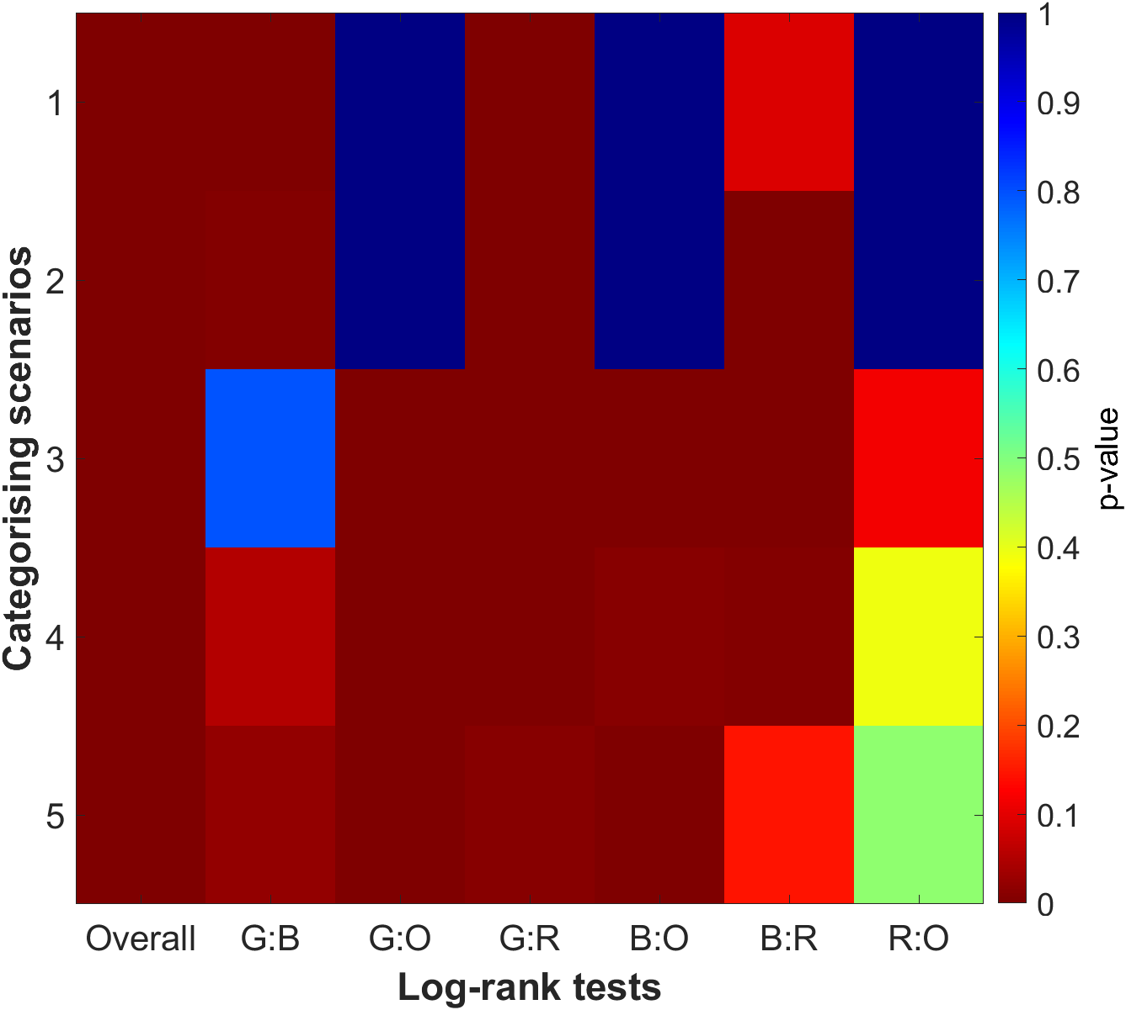
All-cause deaths
# | Categories | Overall p-value |  |  |  |  |  |  | Median years to death
 |  |  | Green Blue | Green Orange | Green Red | Blue Orange | Blue Red | Red Orange
All-cause deaths
1 | <120/80 120/80>BP>160/100 >160/100 | 0.002 | 0.003 | / | <0.001 | / | 0.090 | / | 1.13 2.64 2.51
2 | 0-0.25 0.25-0.45 0.45-0.8 | <0.001 | 0.007 | / | <0.001 | / | 0.003 | / | 2.62 2.54 3.17
3 | 0-0.20 0.20-0.33 0.33-0.50 0.50-0.8 | <0.001 | 0.795 | <0.001 | <0.001 | 0.001 | <0.001 | 0.116 | 2.62 2.54 2.65 2.73
4 | 0-0.20 0.20-0.40 0.40-0.60 0.60-0.8 | <0.001 | 0.053 | <0.001 | <0.001 | 0.009 | 0.005 | 0.391 | 2.75 2.53 3.20 2.01
5 | 0-0.18 0.18-0.38 0.38-0.58 0.58-0.78 | <0.001 | 0.021 | <0.001 | 0.008 | <0.001 | 0.145 | 0.488 | 2.62 2.47 3.18 2.01
Sig.

Slide 26
Repeat Imaging Visit Measure vs Hyper Score

Slide 27
Calculating Instance 3 (2nd Imaging Visit) Hyper Scores
Instance 2 = first imaging visit
Instance 3 = second imaging visit
Find Instance 3 version for all variables (after feature selection) used in cPCA
If variable did not have instances (only 1 recording at instance 0), just re-use what was used previously
Generate the same “feature matrix” as used as the input to cPCA, same order of column, subset of rows from first
New matrix has ~550 columns, ~500 of them were new instance 3 values
New matrix has ~2300 rows as only a portion of patients performed repeat visit
Transform the new matrix into the cPC space using eigen matrix computed during cPCA
Use K-Nearest Neighbour (K = 25) to match new cPC (instance 3) with original cPC (instance 2)
Average out the hyper scores (instance 2) of 25 nearest neighbours to get updated hyper score (instance 3)

Slide 28
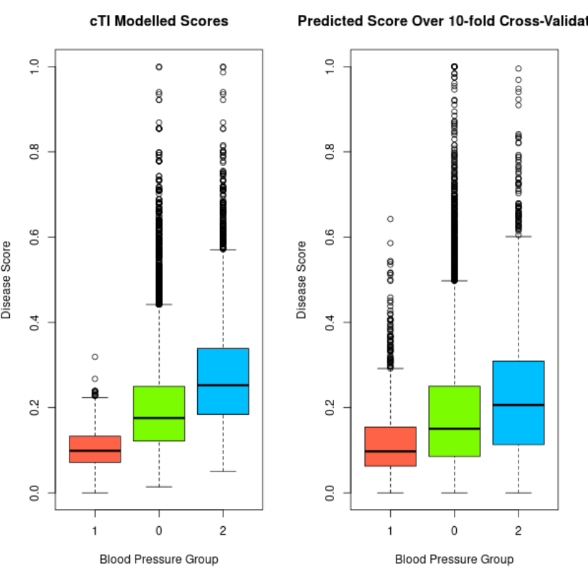
Recap:
Evaluating K-Nearest Neighbour with 10-Fold Cross Validation
(cTI output vs predicted output)

Slide 29
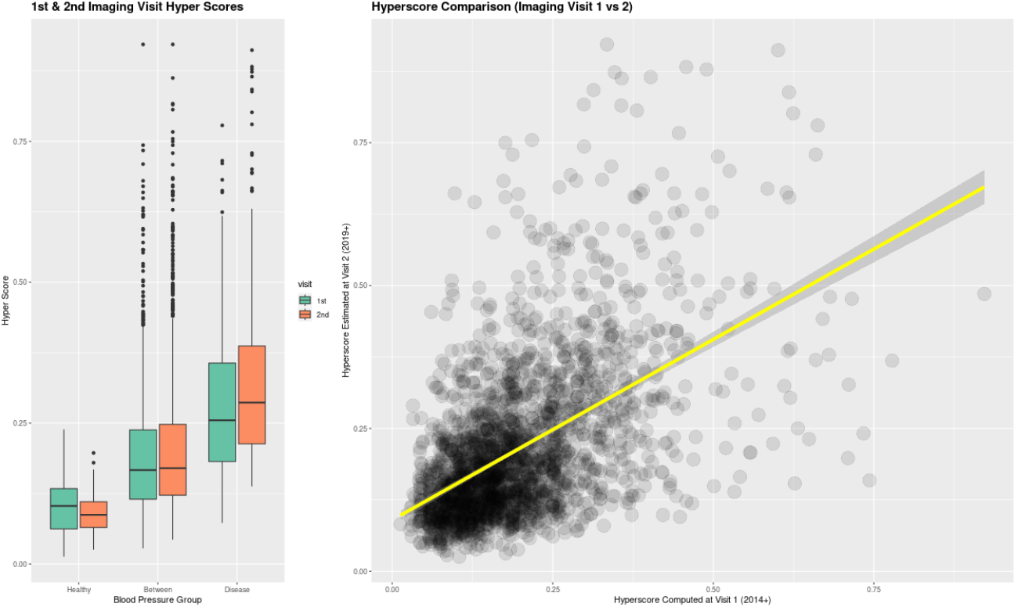

Slide 30
Evaluating Change in Biomarker Value vs Change in Hyper Score
This is not too straight forward as variables change non-linearly at different hyper scores
Fit a loess model using variable and hyper score (imaging visit 1).
Using mean variable value per hyper score interval (0 to 0.1, 0.1 to 0.2 … etc) to get a smooth curve)
Use this model on the new hyper score calculated (imaging visit 2) to predict the biomarker value at imaging visit 2
Compare the predicted biomarker value with the actual reading (imaging visit 2)
This analysis tells us if the biomarker values change in accordance with the changes in hyper score
The relationship is as shown by the fitted loess model, which was already validated
Should this be the other way around? i.e. use actual biomarker value to predict hyper score
Evaluation:
Calculate an error(percentage difference)
Plot correlation of predicted vs real value (at imaging visit 2)
Plot Bland-Altman to compare two distributions (predicted vs real value)

Slide 32
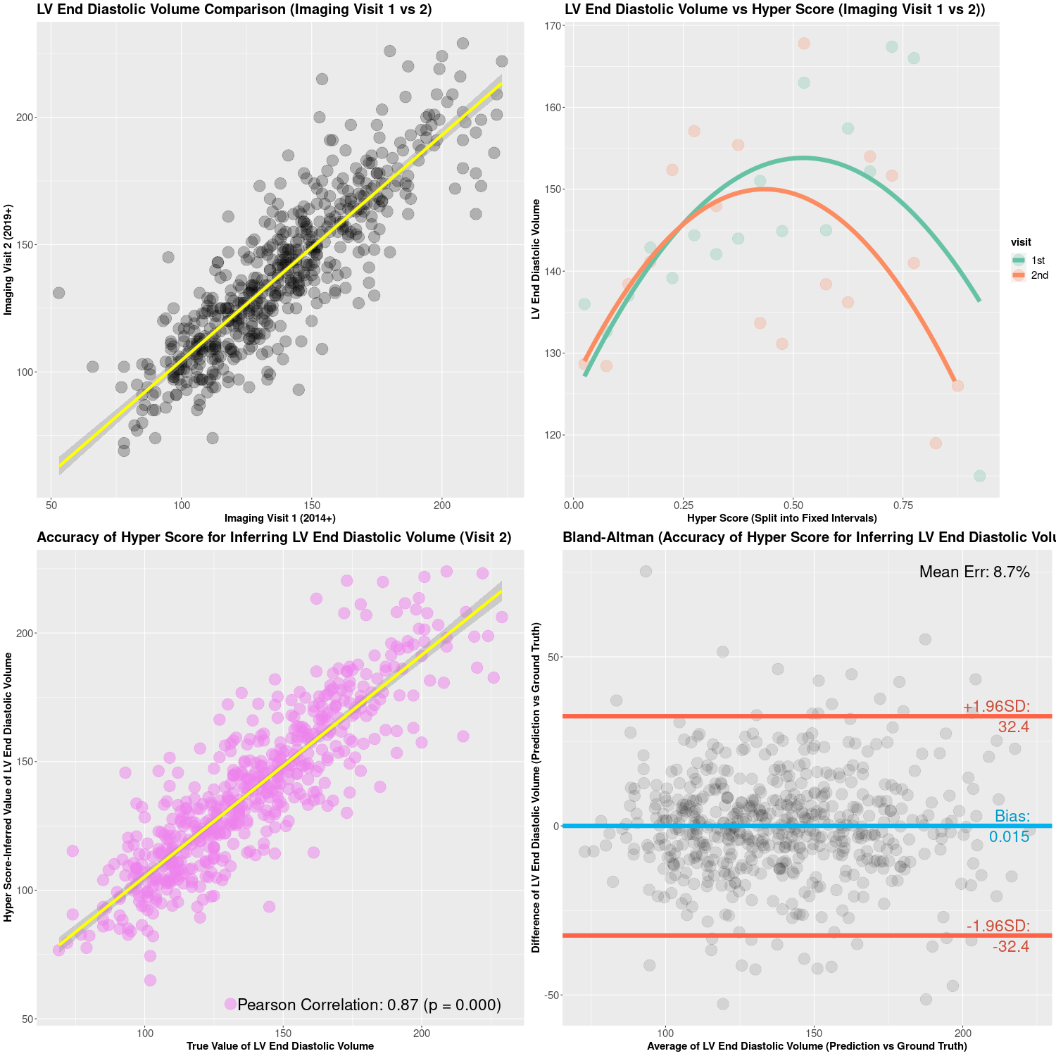

Slide 33
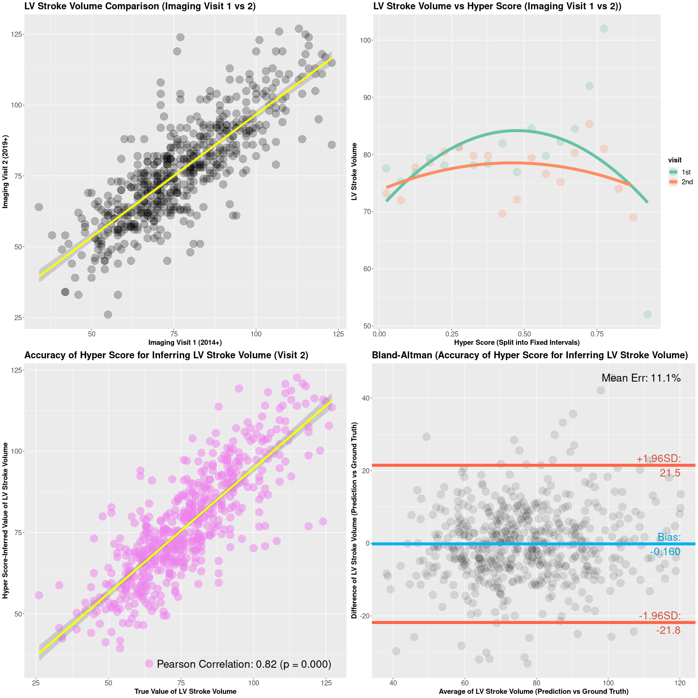

Slide 34
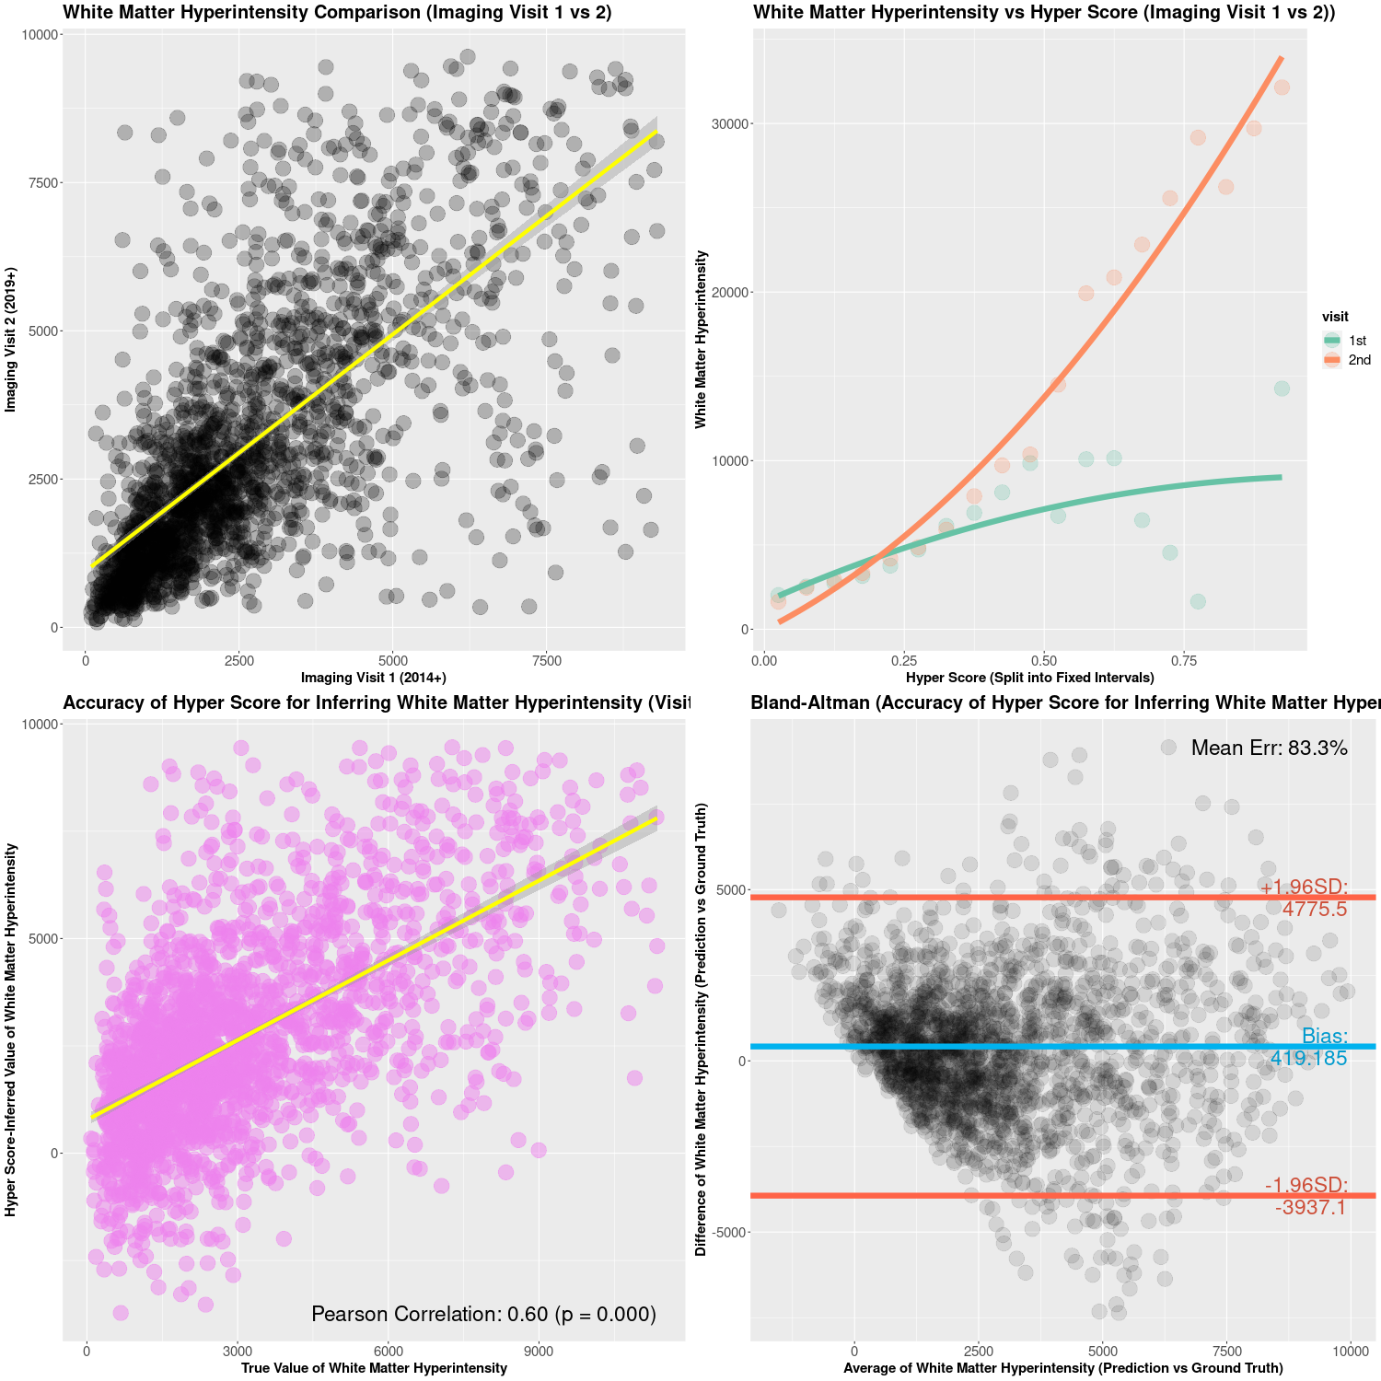

Slide 35
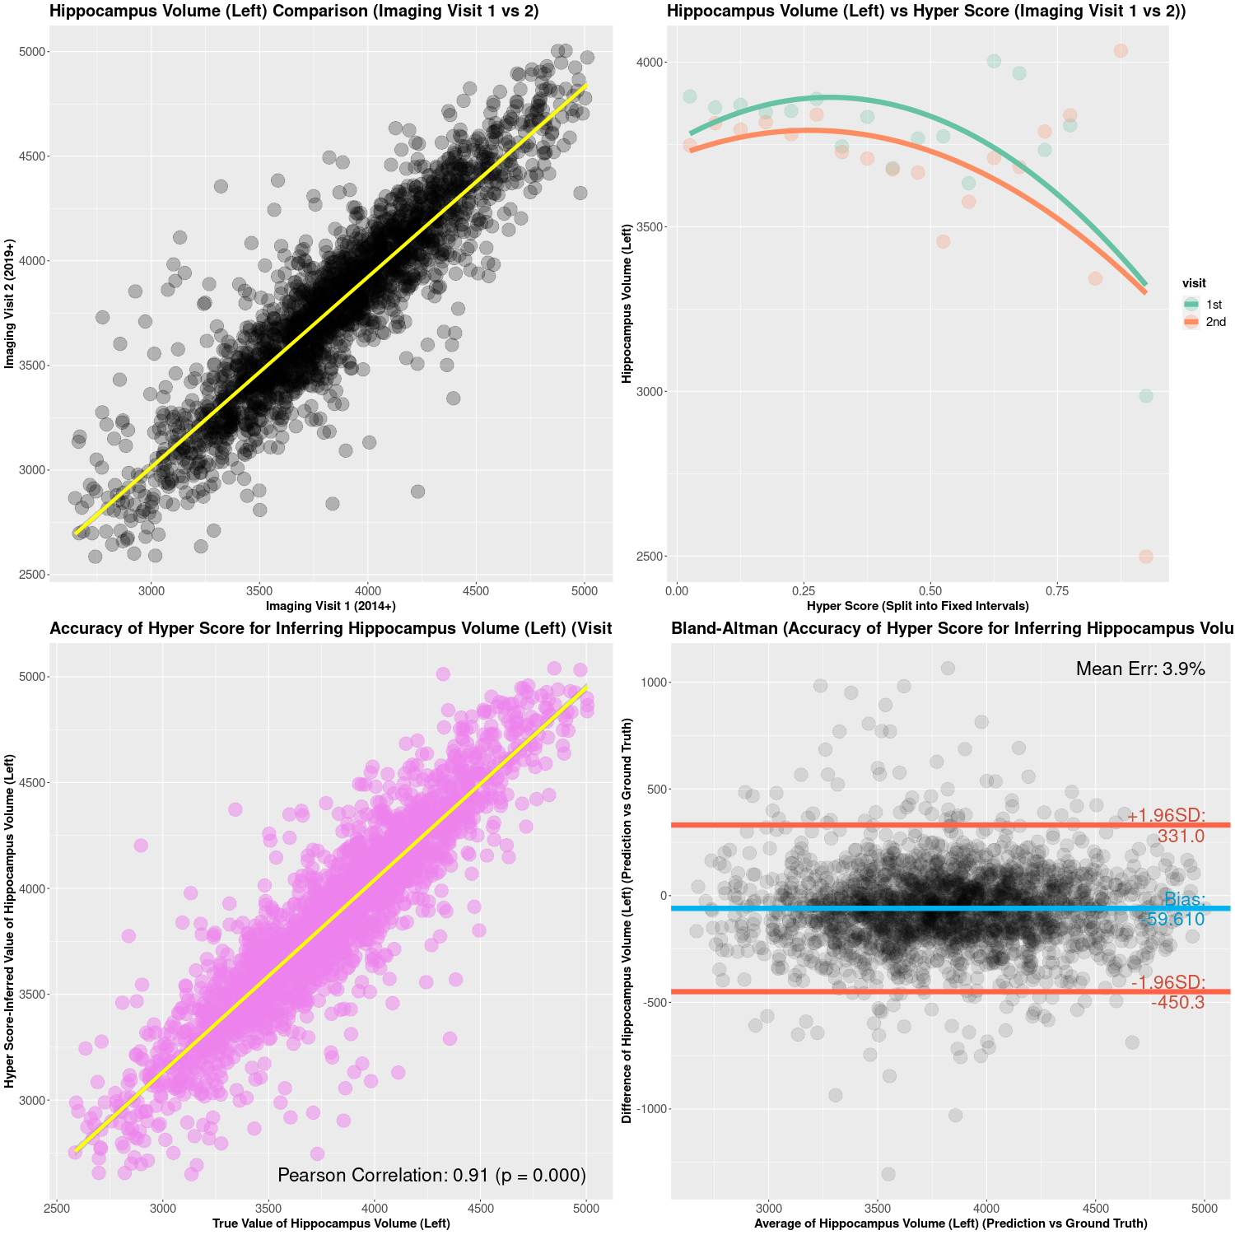

Slide 36
